Slide 1
Doc-Ock
A document classification system

Slide 2
Table of contents
01
02
Problem Statement and Solution
Milestones
03
04
Architecture and Workflow
Live Demo

Slide 3

Problem Statement and Solution

Slide 4


Problem Statement
An application that provides an easy-to-use facility to upload and approve files
An application that automates the task of classifying documents for approval or rejection

Slide 5
Our Solution
A Simple Dashboard
File Uploader
A Machine Learning Model
An Admin View
To upload files and provide their category for confirming approval
Where users can easily view their uploaded files
To approve or reject any misclassifications
That quickly classifies an uploaded file, no more manual work (ɔ◔‿◔)ɔ ♥

Slide 6
Milestones Covered
01
02
03
04
Analysing the requirements and the suitable tech stack
Creating an ML model that classifies the files
Building a basic frontend for displaying files and a backend for authentication and storage
Integrating individual components to build the final product

Slide 7
Document Uploading
Store
Both images and pdf documents
Retrieve
Complete list of documents uploaded
Categorize
Documents based on certain classes and receive feedback through emails

Slide 8
Classifies
Document Classifier
Text Extraction
Preprocessing
Given document based on text present in the document
To obtain the text in an image or pdf using pytesseract
Of the document and its text. PDF documents are converted to images.

Slide 9
Classifiers Used
Supported File Types
Linear SVM
Naive Bayes
PDF
PNG
JPG
JPEG
WEBP

Slide 10
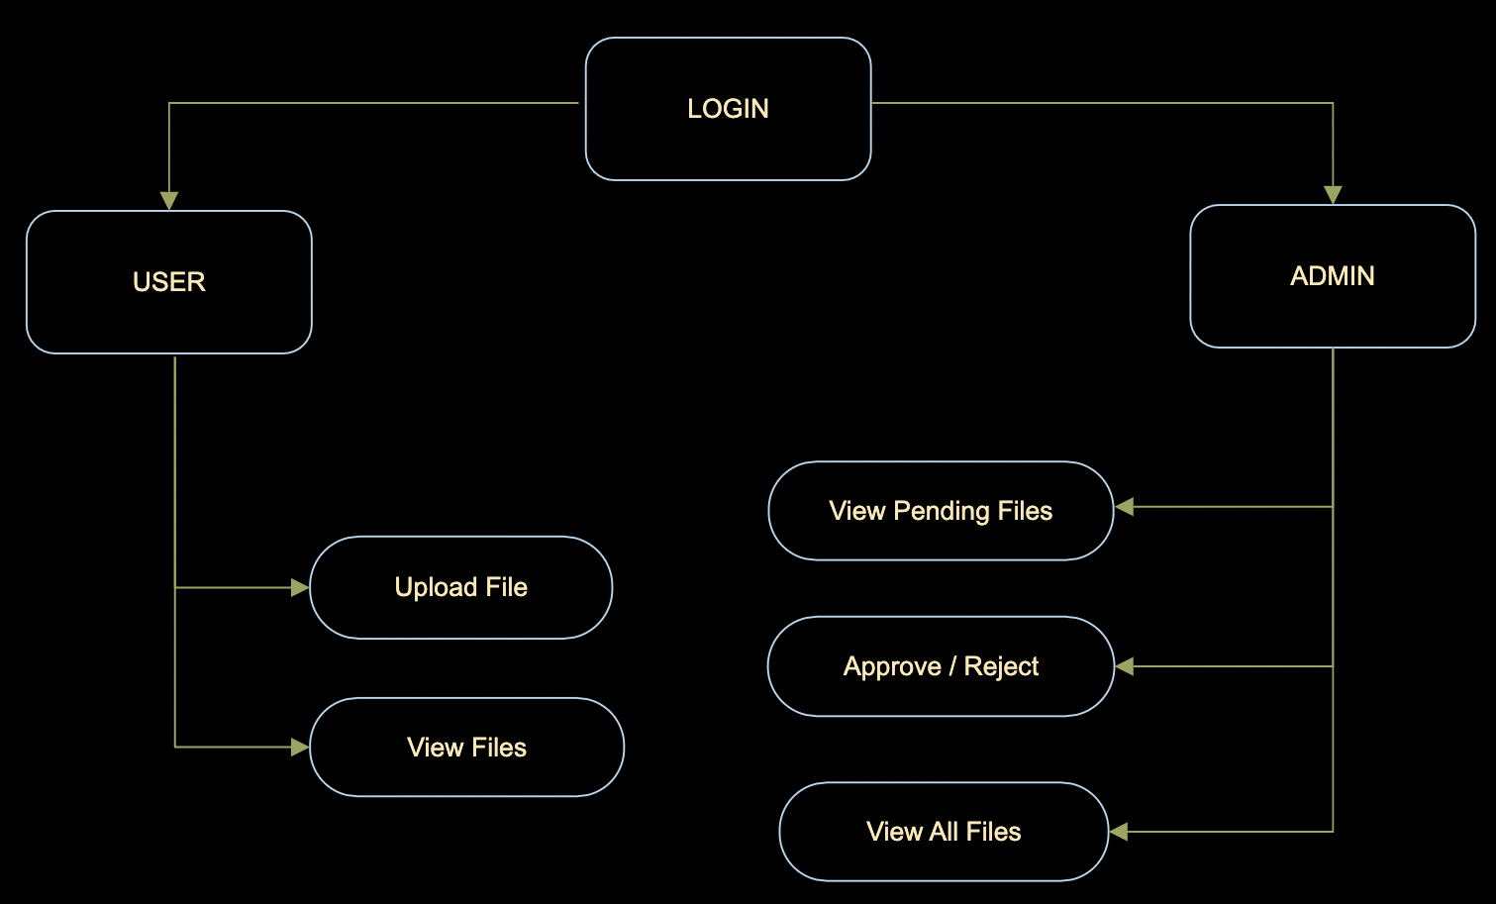
Workflow

Slide 11
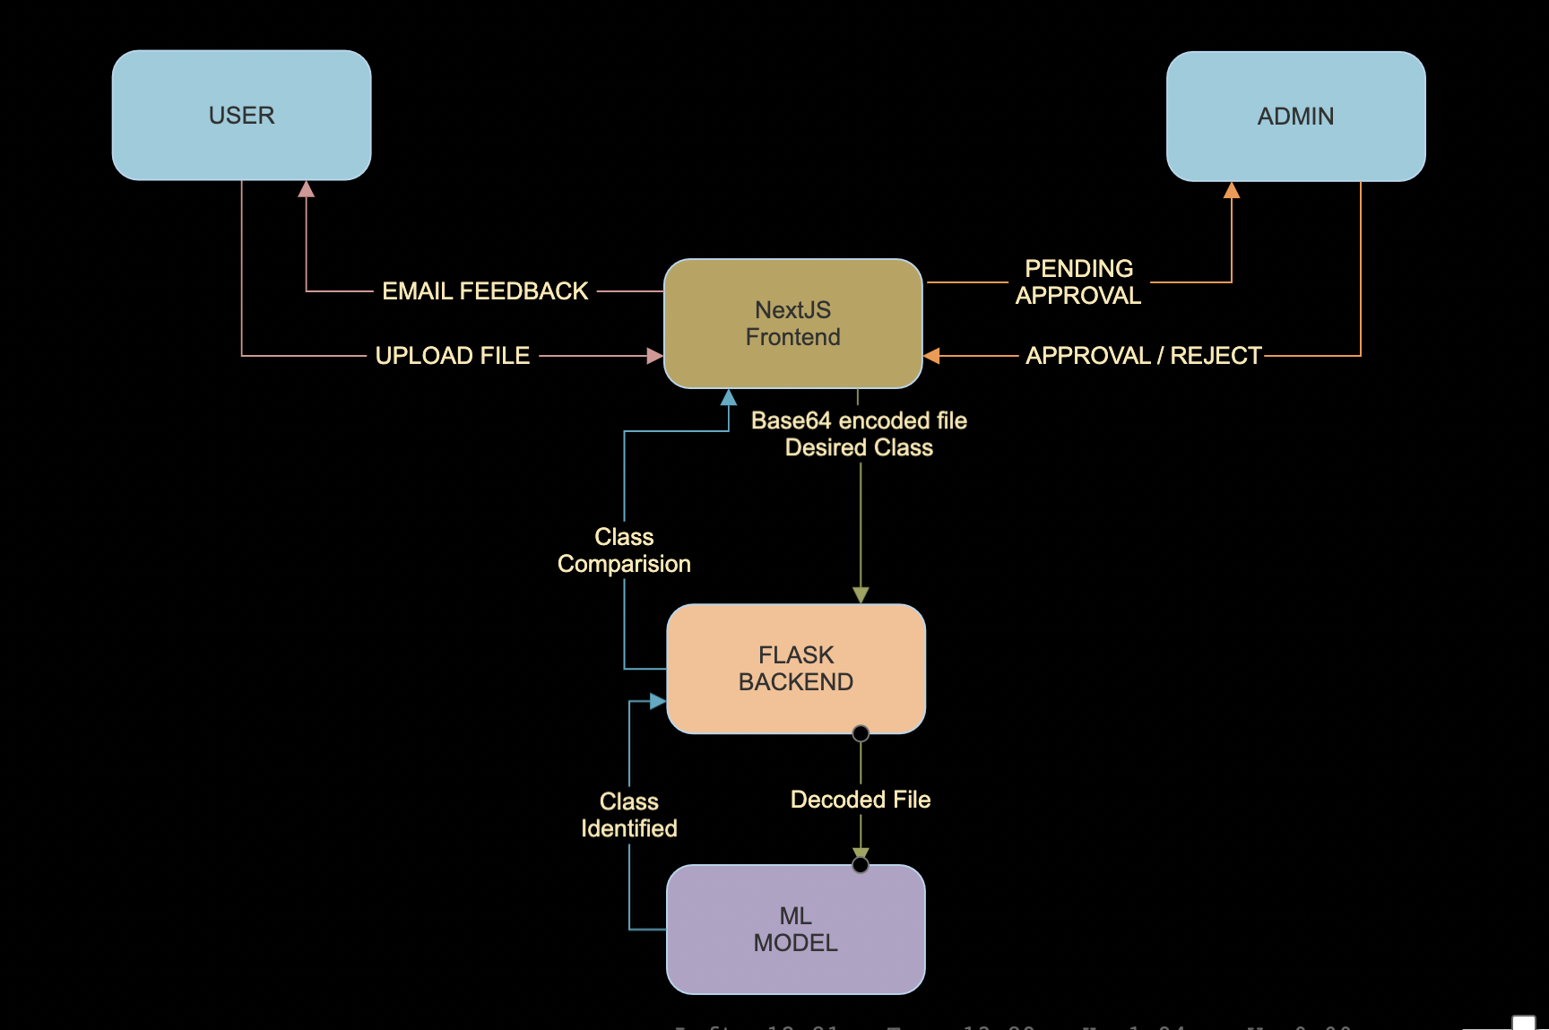
How about the percentages?
35%
50%
15%
Mercury
Neptune
Venus
Mercury is the closest planet to the Sun
It is the farthest planet from the sun
It has a beautiful name, but it’s very hot

Slide 12
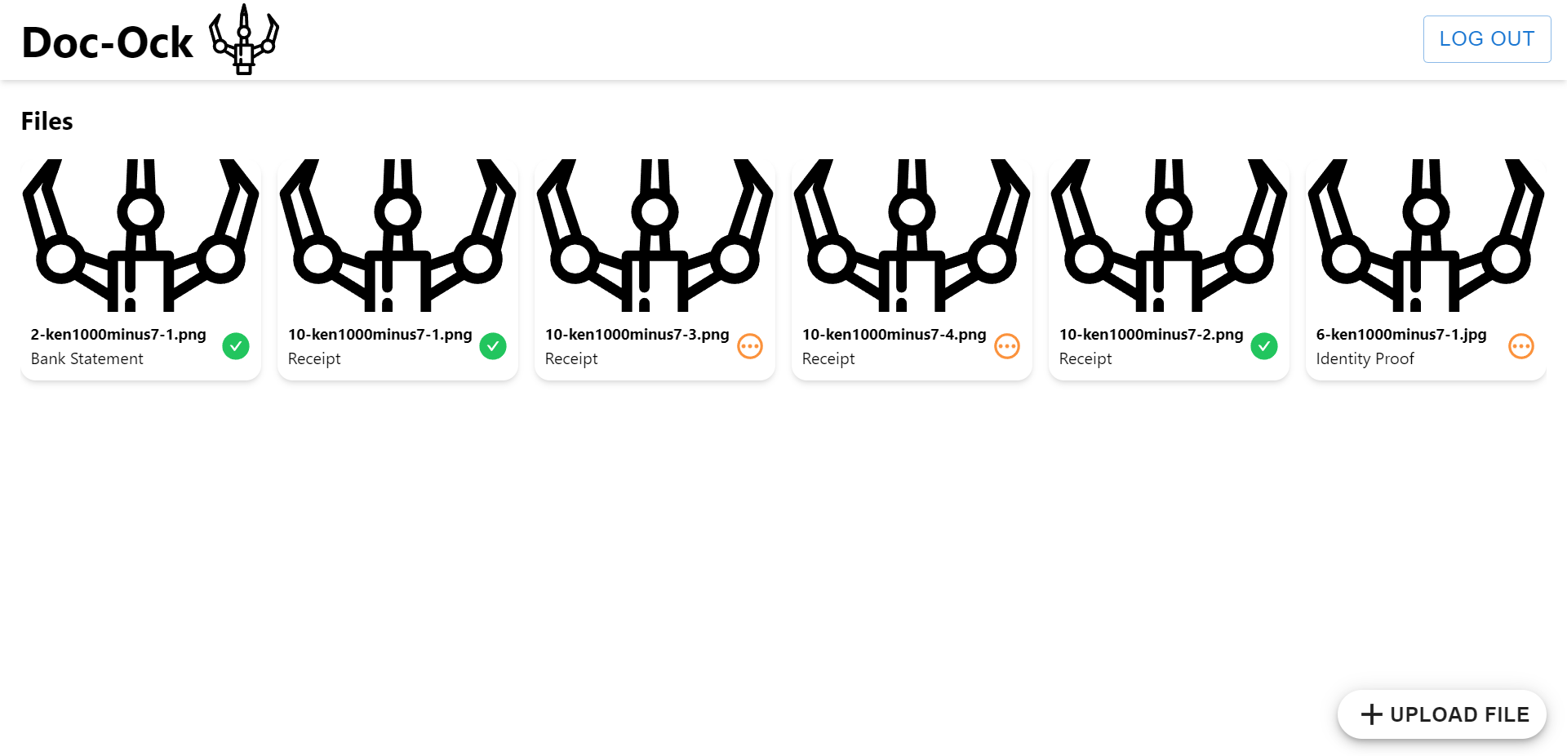
Live Demo

Slide 13
Thank You
(✿◠‿◠)

